Slide 1
.NET of Things

Slide 2
What this talk is:
100 Level Overview
.NET

Slide 3
What this talk isn’t:
Electronics
Native C/C++
Anything Internet related

Slide 4
Word Cloud
C#
.NET Core
.NET Standard
UWP
Gadgeteer
.NET MicroFramework
TinyCLR OS
Meadow

Slide 5
Raspberry Pi
ARM CPU
“Low Resources”
1.4 GHz 64 bit CPU
1 GB RAM
Pi 3 B+
Exposed Pins
The Money Maker

Slide 6
.NET MicroFramework
Legacy
Designed for MCUs
RAM ~300KB
CPU like Cortex-M3 @ 120 MHz
Limited in features
No generics
Limited MCU selection
Open Source
http://netmf.github.io/
Netduino 2 courtesy of https://www.wildernesslabs.co/

Slide 7
Cons
Limited Language Feature Support
No Generics
Required VS Extension to begin
Only worked on Community Version of VS
Maxed out at VS 2015

Slide 8
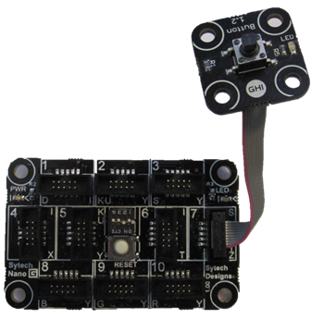
Gadgeteer
Extension of .NET MicroFramework
Easy Prototyping Platform
Expensive
Open Source
https://archive.codeplex.com/?p=gadgeteer
GHIElectronics FEZ Hydra
with Button module

Slide 12
TinyCLR OS
Created by GHI Electronics
https://www.ghielectronics.com/tinyclr/features
Can be ported to custom hardware
Modules hosted on NuGet
Not open source
Though documentation is
Supports native C/C++ code
No Generics Support

Slide 13
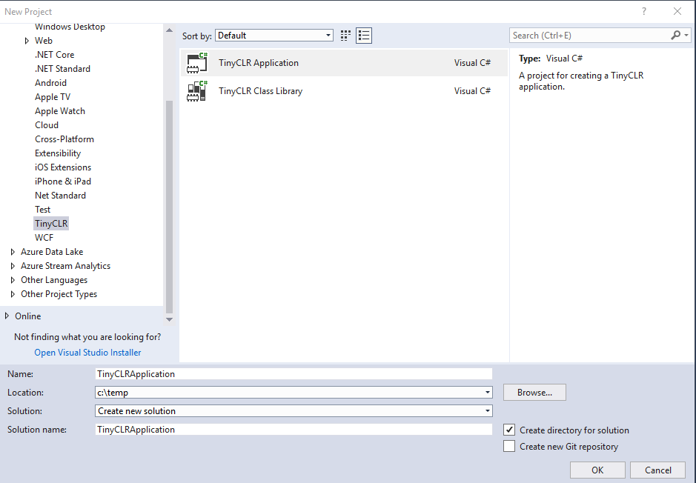
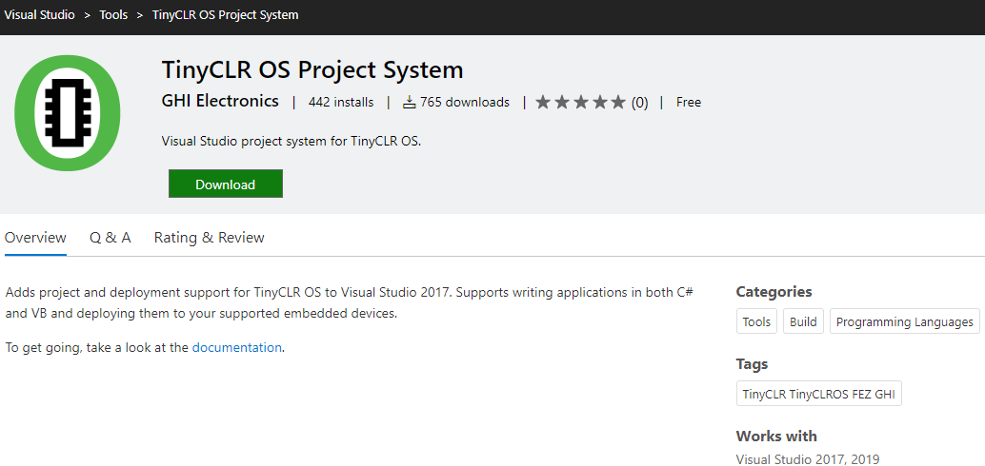
TinyCLR OS – Getting Setup
Follow simple instructions online
https://docs.ghielectronics.com/software/tinyclr/getting-started.html
Install “TinyCLR OS Project System” Extension to VS
https://marketplace.visualstudio.com/items?itemName=ghielectronics.tinyclr-projectsystem
Create new project

Slide 14
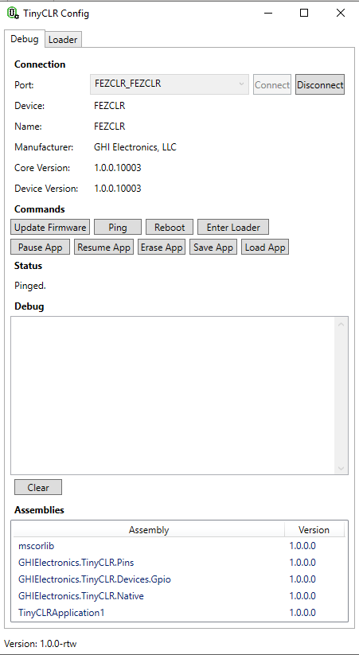
TinyCLR Config
Application to update device Firmware
Debug board
Might need this on first use of new board

